Slide 1
Fundamentals of Nursing(1st Stage)
Oral medications
(theory)
Assist.lect.Ahmed thamer saud
University of Basrah –College of Nursing – Fundamentals of Nursing Department

Slide 2
Oral medication
Oral administration of drugs is the most common route; however, there are potential risk factors that the nurse must consider before administering oral drugs, the nurse should assess the client’s ability to take the medication as prescribed. This assessment includes the client’s gag reflex, state of consciousness, and presence of nausea and vomiting.

Slide 3
The nurse should protect the client against aspiration when administering any form of oral drug. Aspiration refers to the inhalation of regurgitated gastric contents into the pulmonary system. If a client has a weak gag reflex or difficulty swallowing water, medication can be inhaled during medication administration.

Slide 4
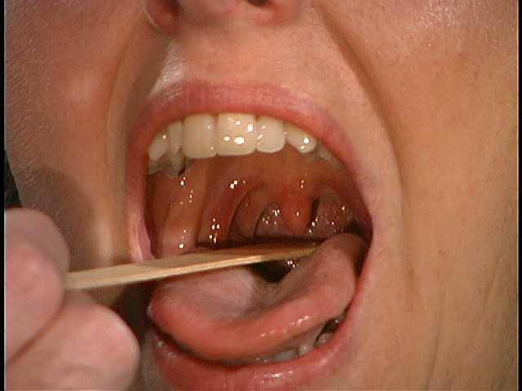
To prevent aspiration, the nurse confirms the client’s gag reflex and ability to swallow. When administering an oral drug, the nurse prepares the medication, correctly identifies the client, and provides some form of liquid. The nurse should remain with the client until all of the medications have been swallowed.

Slide 5
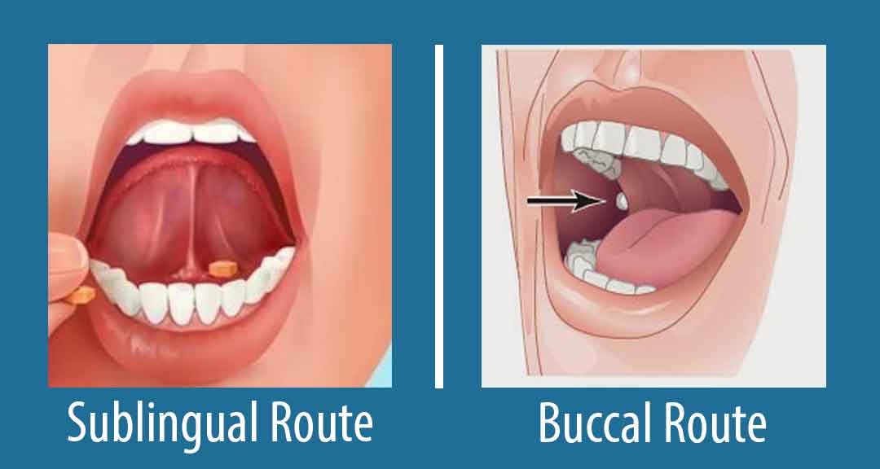
Sublingual and Buccal Drug Administration
Sublingual and buccal drugs are types of oral medications. Certain drugs are given by these routes to prevent their destruction or transformation in the stomach or small intestines The nurse should assess the integrity of the mucous membranes by inspecting underneath the client’s tongue and in the buccal cavity.

Slide 6
If the membranes are excoriated or painful, the nurse should withhold the medication and notify the health care practitioner. Some buccal drugs may irritate the mucosa, requiring the nurse to use alternate sides of the mouth to prevent irritation of the mucosa.
Sublingual and buccal administration of drugs requires the nurse to use Standard Precautions because the nurse’s hand may come into contact with oral secretions.
Drugs given by these routes are quickly absorbed by the mucosa’s thin epithelium
and the abundant blood supply.

Slide 7
Enteral Instillation of Drugs
Enteral Instillation refers to the delivery of drugs through a gastrointestinal tube. Enteral tubes provide a means of direct instillation of medications into the gastrointestinal system of clients who cannot ingest it orally.
There are several types of enteral tubes:
1-Nasogastric tube (NG) is a soft rubber or plastic tube that is inserted through a nostril and into the stomach
2- Gastrostomy tube is surgically inserted into the stomach through the creation of an artificial fistula.

Slide 8
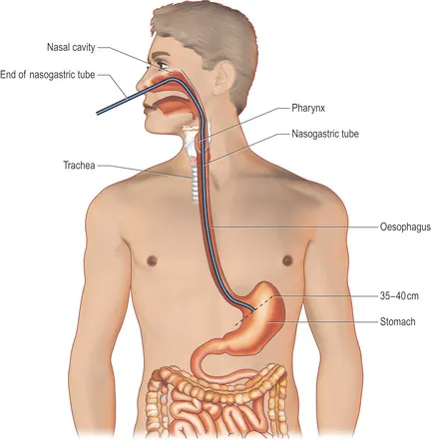

Slide 10
The nurse should assess the client for the presence of bowel sounds and check the tube for patency (openness) and placement before administering a medication. The instillation of drugs is contraindicated when the tube is obstructed or improperly placed, when the client is vomiting, or if bowel sounds are absent.
the nurse should crush the tablet into minute particles and dissolve the crushed tablet in 15 to 30 ml of warm water before instillation.
Capsules are prepared for administration by opening the capsule and emptying the contents into a liquid.

Slide 11
Equipment
Medication administration record (MAR)
Medication cup
Medication cart or tray
Medication properly labeled
Glass of water or juice
Straw

Slide 12
Nursing checklist administering sublingual and buccal drugs
• Follow the six rights of safe drug administration.
• Wash your hands and don nonsterile gloves.
• Assess the client’s knowledge of the drug and its action.
• Explain the procedure to the client, and allow the client time to ask questions.
• Offer the client a sip of water and explain to the client that liquids cannot be taken until the tablet is completely dissolved.

Slide 13
• To give a drug sublingually, ask the client to open the mouth and lift the tongue; place the drug under the client’s tongue. Give the client the following instructions:
—Keep the medication under the tongue until it dissolves completely to ensure absorption.
—Avoid chewing the tablet or touching the tablet with the tongue to prevent accidental swallowing.
—Do not smoke before the drug has completely dissolved because nicotine has a vasoconstriction effect that slows absorption.

Slide 14
Why we instruct the patient by say (Do not smoke before the drug has completely dissolved ) when we give medication by sublingually route?

Slide 15
• To give a drug buccally, instruct the client to open the mouth wide, and place the tablet between the client’s cheek and teeth. Give the client the following instructions:
—Keep the medication in place until it dissolves completely to ensure absorption.
—Do not drink liquids for an hour because some tablets take up to an hour to dissolve.
—Do not smoke before the drug has completely dissolved because nicotine has a vasoconstriction effect that slows absorption.
• Remove gloves and dispose in a proper receptacle; wash hands.
• Document the medication administration on the Medication administration record (MAR). When the client is receiving repeated doses of a buccal medication, the nurse should indicate the site, such as right buccal cavity, to prevent irritation of the same site.

Slide 16
Nursing Checklist Instilling Drugs Into Enteral Tubes
• Wash hands and don nonsterile gloves.
• Place the client in a high or semi-Fowler’s position.
• Attach the syringe to the free end of the tube, pour 30 ml of medication into the syringe barrel, and open the clamp; for NG tube instillation, hold the NG tube at the client’s nose level.
• Hold the syringe barrel at a slight angle and allow the medication to flow at a steady, slow rate; add more medication before the syringe empties to prevent air from entering the stomach. If necessary, adjust the height of the NG tube to achieve a steady flow rate. Never push medications into the tube.

Slide 17
• Observe the client while instilling the medication. If the client experiences any discomfort, slow the rate by lowering the height of the syringe.
• As the syringe barrel begins to empty with the last of the medication, slowly add 30 to 50 ml of room-temperature water into the syringe to clear the medication from the sides and distal end of the tube to prevent clogging.
• Before the syringe empties of water, clamp the tube, and detach and dispose of the syringe.

Slide 18
• Position the client as appropriate; clients with an NG tube should be the head of the bed slightly elevated for at least 30 minutes after the instillation to prevent aspiration.
• Clean area, remove and dispose of gloves in the proper receptacle, and wash hands.
• Document the instillation of the medication on the MAR and record on the intake and output sheet the total amount of fluid instilled.

